Slide 1
HDDS1104 Operating Systems and Networking
Topic 07a – Network Layer

Slide 2
Intended Learning Outcomes
Describe the IP Datagram format
Explain the classful & classless IP addressing
Design a subnet for a network
Distinguish the difference between classful and classless IP addressing
Describe NAT & DHCP protocols
Briefly describe IPv6 addressing

Slide 3
(Recall) Internet Protocol Data Flow
Application Layer
Application Layer
Transport Layer
Transport Layer
Network Layer
Network Layer
Network Layer
Network Layer
Data-Link Layer
Data-Link Layer
Internet
Data-Link Layer
Data-Link Layer

Slide 4
Network Layer – IPv4
IPv4 Datagram Format
IP Fragmentation & Reassembly
IP Addressing
Network Address Translation (NAT)
Dynamic Host Control Protocol (DHCP)

Slide 5
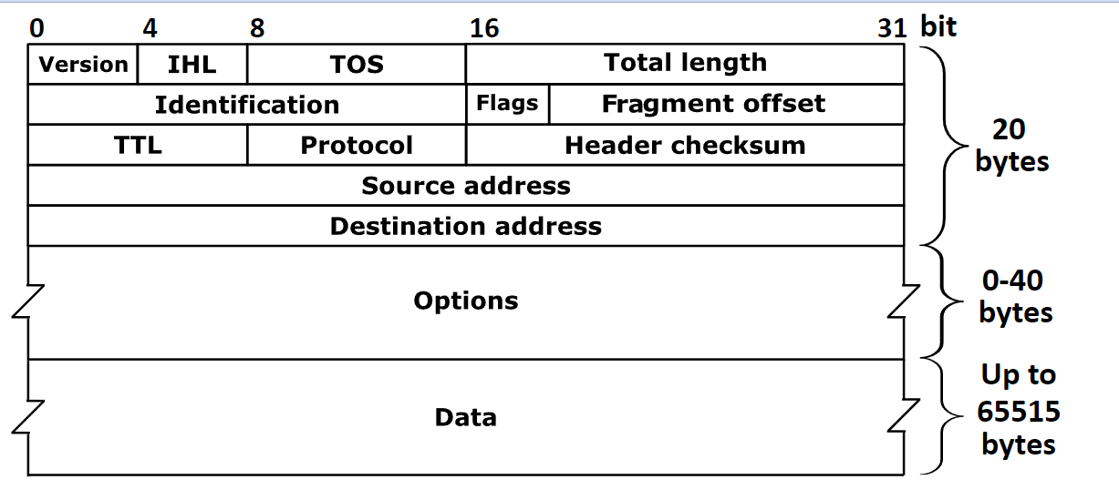
IPv4 Datagram Format
IHL
Header Length
TOS
Type of Service
TTL
Time to Live
Protocol
Upper Layer Protocol
By Michel Bakni, CC BY-SA 4.0, https://commons.wikimedia.org/w/index.php?curid=79949694
Notes:
By Michel Bakni - Postel, J. (September 1981) RFC 791, Internet Protocol, DARPA Internet Program Protocol Specification, The Internet Society, p. 11 DOI: 10.17487/RFC0791., CC BY-SA 4.0, https://commons.wikimedia.org/w/index.php?curid=79949694

Slide 6
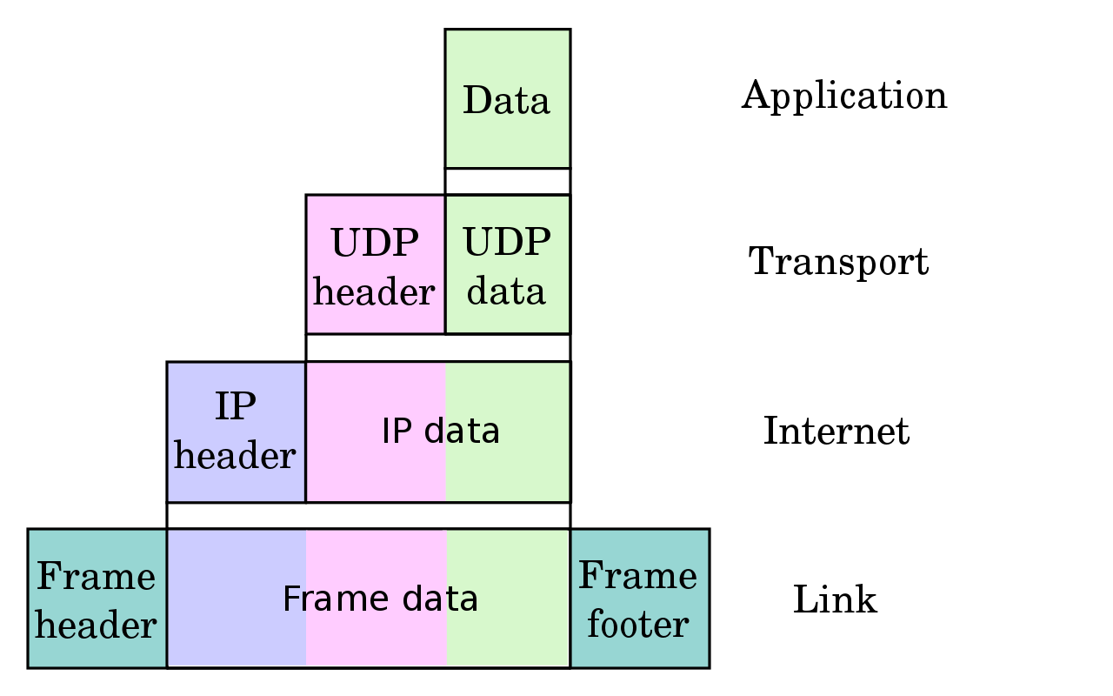
IP Header fields
Header length
Units of 32-bit words
Identification
Sending host puts an Identification number in each datagram
Total length
Length of user data + header in bytes

Slide 7
IP Fragmentation fields
Fragment offset
Position of fragment in original datagram
Multiples of 8byte block
More fragments flag
Indicates that this is not the last fragment
Datagram can be fragmented/re-fragmented at any router
Datagrams are reassembled only at the destination host

Slide 8
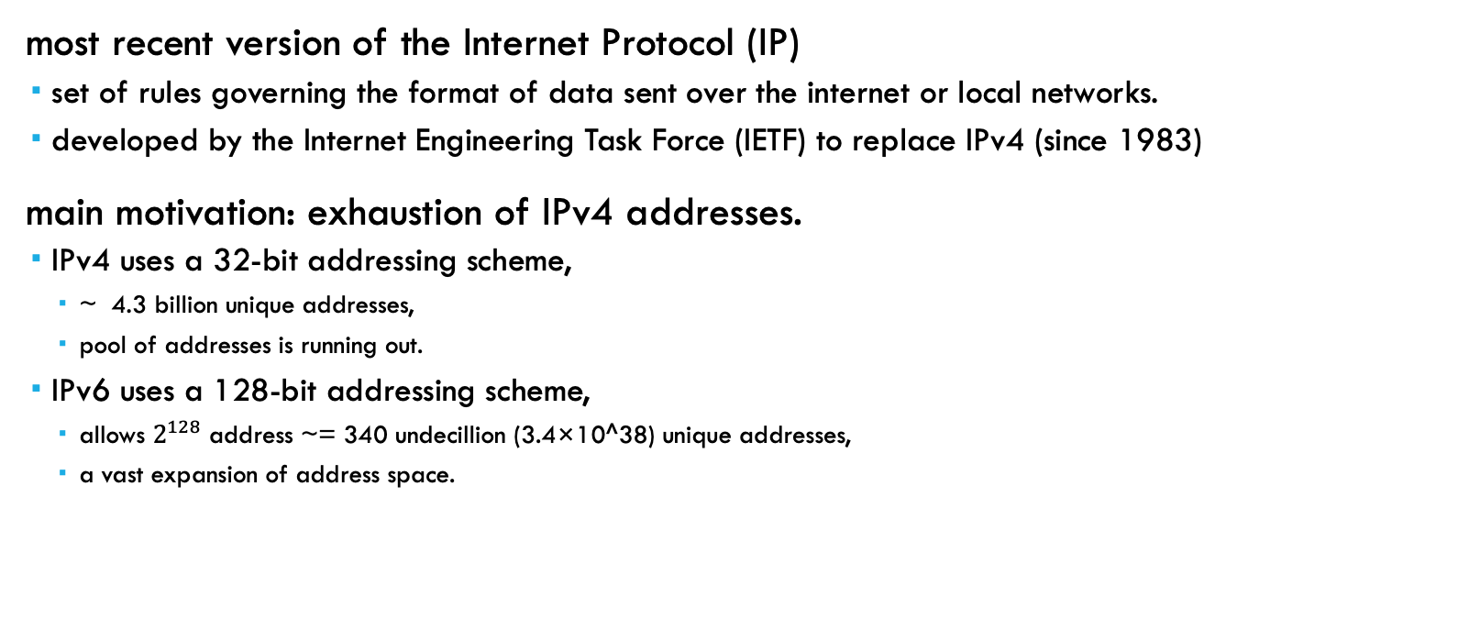
Internet Protocol version 6 (IPv6)
most recent version of the Internet Protocol (IP)
set of rules governing the format of data sent over the internet or local networks.
developed by the Internet Engineering Task Force (IETF) to replace IPv4 (since 1983)
main motivation: exhaustion of IPv4 addresses.
IPv4 uses a 32-bit addressing scheme,
~ 4.3 billion unique addresses,
pool of addresses is running out.
IPv6 uses a 128-bit addressing scheme,
allows $2^{128}$ address ~= 340 undecillion (3.4×10^38) unique addresses,
a vast expansion of address space.

Slide 9
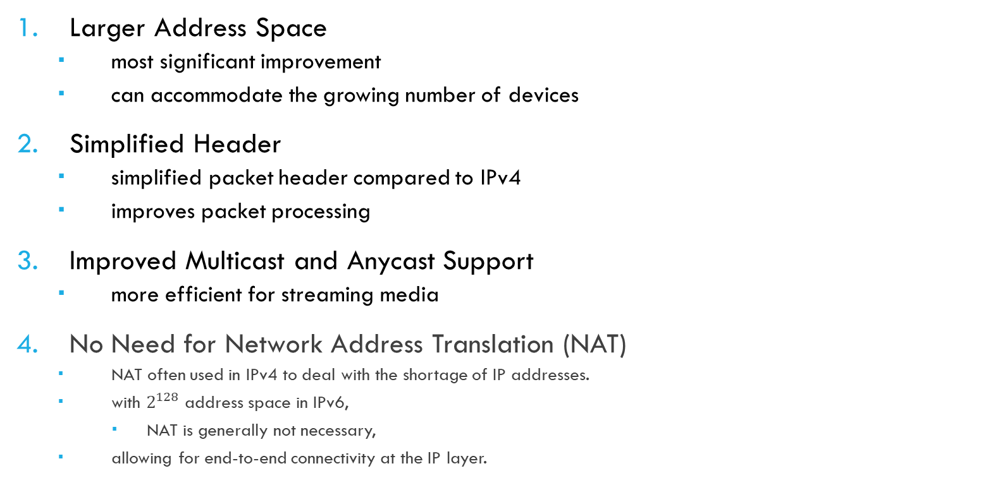
Key Features of IPv6
Larger Address Space
most significant improvement
can accommodate the growing number of devices
Simplified Header
simplified packet header compared to IPv4
improves packet processing
Improved Multicast and Anycast Support
more efficient for streaming media
No Need for Network Address Translation (NAT)
NAT often used in IPv4 to deal with the shortage of IP addresses.
with $2^{128}$ address space in IPv6,
NAT is generally not necessary,
allowing for end-to-end connectivity at the IP layer.

Slide 10
Key Features of IPv6
Autoconfiguration:
supports stateless address autoconfiguration (SLAAC)
allows devices to configure themselves automatically when connected to a network,
simplifying network management.
Better Security: designed with IPsec,
a suite of protocols for securing internet protocol communications
by authenticating and encrypting each IP packet of a communication session.
Mobility
allowing mobile devices to move between different networks without losing their connections.
Extensibility
easily extended for new features
by adding extension headers after the IPv6 header.

Slide 11
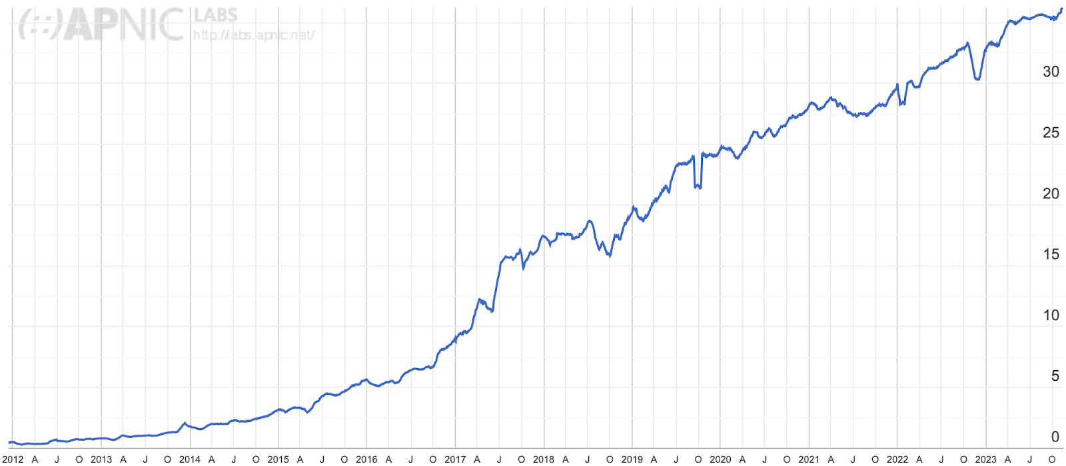
Estimate IPv6 adoption
Source: “Using DNS to estimate the worldwide state of IPv6 adoption” - https://blog.cloudflare.com/ipv6-from-dns-pov
Notes:
As of 2023-12-14
https://blog.cloudflare.com/ipv6-from-dns-pov

Slide 12
Transition to IPv6
Despite the advantages,
transition to IPv6 has been gradual
need to update infrastructure
IPv4 & IPv6 networks are not directly compatible.
Dual-stack networks,
devices run both IPv4 and IPv6,
common during this transition period

Slide 13
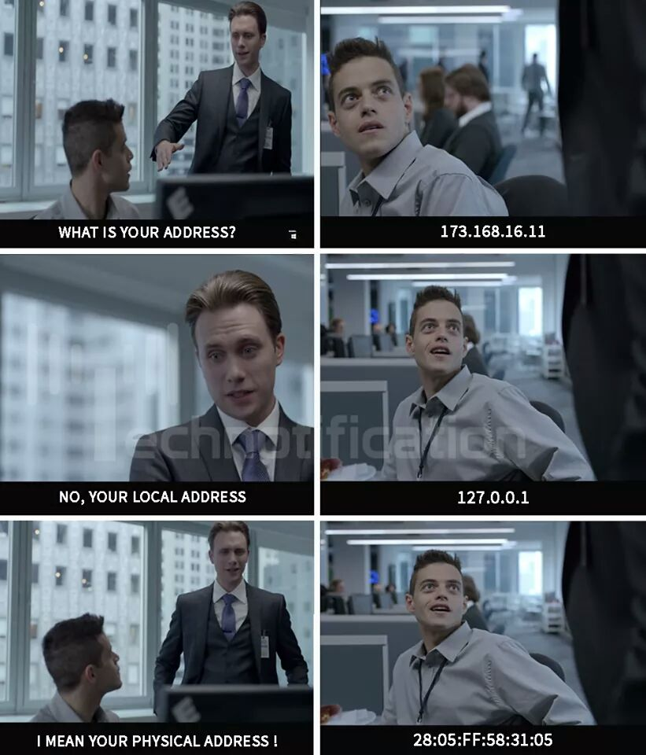
IPv4 Address
https://imgur.com/fbrxjMk

Slide 14
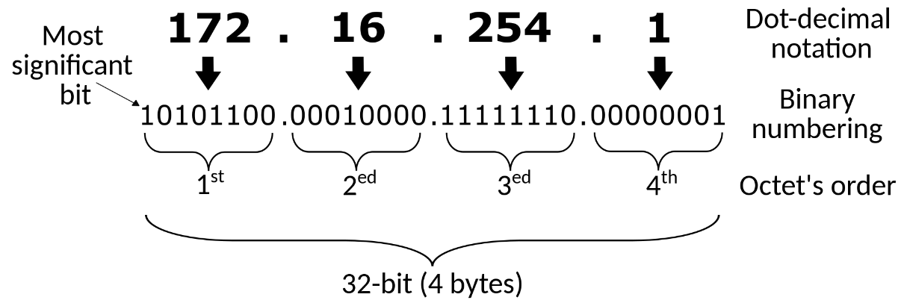
Recall - IP Address (Topic 05)
A numeric label used for network interface identification and location addressing
Each network interface has a unique IP address inside a network
IPv4
A 32-bit number
E.g.: 192.0.2.1
IPv6
128-bit number
E.g.: 2001:db8:0:1234:0:567:8:1

Slide 15
IPv4 Address
Classful Addressing
Network masking
Classless Inter-Domain Routing (CIDR)
Sub-network
Private networks

Slide 16
IPv4 Classful Addressing
Obsolete network addressing architecture
Used until Classless Inter-Domain Routing (CIDR) in 1993
Partitioned into 5 classes (A to E)
A, B & C: unicast addresses
D: multicast
E: reserved for future purpose
Used: default configuration of subnet masks
Reference: https://en.wikipedia.org/wiki/Classful_network

Slide 17
IP Address classes - Bits & Addresses
Class | Leading bits | Size of network number bit field | Size of rest bit field | Number of networks | Addresses per network
Class A | 0 | 8 | 24 | 128 | 16,777,216
Class B | 10 | 16 | 16 | 16,384 | 65,536
Class C | 110 | 24 | 8 | 2,097,152 | 256
Class D (multicast) | 1110 | not defined | not defined | not defined | not defined
Class E (reserved) | 1111 | not defined | not defined | not defined | not defined

Slide 18
IP Address - ranges
Class | Leading bits | Start address | End address | Default subnet mask in dot-decimal notation | CIDR notation
Class A | 0 | 0.0.0.0 | 127.255.255.255 | 255.0.0.0 | /8
Class B | 10 | 128.0.0.0 | 191.255.255.255 | 255.255.0.0 | /16
Class C | 110 | 192.0.0.0 | 223.255.255.255 | 255.255.255.0 | /24
Class D (multicast) | 1110 | 224.0.0.0 | 239.255.255.255 | not defined | /4
Class E (reserved) | 1111 | 240.0.0.0 | 255.255.255.255 | not defined | not defined

Slide 19
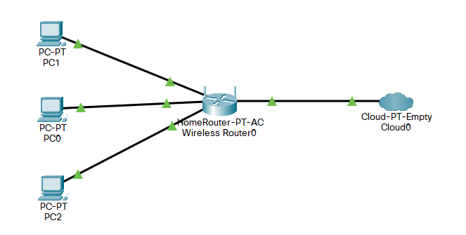
IP Addressing
Same network prefix
192.168.0.101
116.48.249.243
192.168.0.100
192.168.0.1
192.168.0.102

Slide 20
Network masking
All hosts on the sub-network have the same prefix
Position of the prefix
Indicated by subnet mask
Class C: 192.168.0.101 / 255.255.255.0

Slide 21
Subnet mask - Example
In a subnet mask:
Binary 1s represent the network portion of the IP address.
Binary 0s represent the host portion.
IP / Subnet = 192.168.0.101 / 255.255.255.0
Network ID = 192.168.0
Host ID = 101
IP Address | 11000000 10101000 00000000 01100101
Subnet Mask | 11111111 11111111 11111111 00000000
Network | 11000000 10101000 00000000 00000000
Role of Subnet Mask - GeeksforGeeks
Subnet Mask - Explained

Slide 22
Classless Inter-Domain Routing (CIDR)
Subnet portion -> arbitrary length
Address Format: a.b.c.d/x
x: # of bits in subnet portion
Example: 192.168.0.101/24
Can define sub-network using longer subnet portion
https://en.wikipedia.org/wiki/Classless_Inter-Domain_Routing

Slide 23
Sub-network Example
Network addresses can be sub-divided into more sub-network
Class B: 130.0.0.1/16
Office need 120 IP address
First IP will be 130.0.3.1
Calculate the subnet mask for this sub-net in both binary and decimal form.

Slide 24
Sub-network Example
First IP will be 130.0.3.1
120 IP addresses -> 128 bits host ID (7 bits)
Subnet portion = 32 - 7 bits = 25 bits
Subnet mark = 255.255.255.128
IP Address | 10000010 00000000 00000011 00000001
Subnet Mask | 11111111 11111111 11111111 10000000
Network | 10000010 00000000 00000011 00000000

Slide 25
Subnet Exercise
Consider a router that interconnects 2 subnets:
Subnet 1, and Subnet 2.
Suppose all of the interfaces in each of these three subnets are required to have the prefix 224.1.1/24.
Subnet 1 is required to support up to 20 interfaces,
Subnet 2 is to support up to 96 interfaces,
Provide 2 network address prefixes (of the form a.b.c.d/x) that satisfy these constraints.
Use adjacent allocations.
For each subnet, also list the subnet mask to be used in the hosts.

Slide 26
Subnet Exercise - Draft

Slide 27
Private network
network that uses a private address space of IP addresses.
commonly used for local area networks (LANs)
Private network addresses
not allocated to any specific organization.
Anyone may use these addresses without approval
originally defined to assist in delaying IPv4 address exhaustion.
IP packets originating from or addressed to a private IP address cannot be routed through the public Internet.
https://en.wikipedia.org/wiki/Private_network

Slide 28
Private IPv4 addresses
IETF has directed the IANA to reserve the following IPv4 address ranges for private networks:
Classful description | IP address range | Mask bits | Host ID size | Number of addresses
single class A network | 10.0.0.0 – 10.255.255.255 | 8 bits | 24 bits | 16,777,216
16 contiguous class B networks | 172.16.0.0 – 172.31.255.255 | 12 bits | 20 bits | 1,048,576
256 contiguous class C networks | 192.168.0.0 – 192.168.255.255 | 16 bits | 16 bits | 65,536
Notes:
Internet Engineering Task Force (IETF) has directed the Internet Assigned Numbers Authority (IANA)

Slide 29
Difference between classful and classless IP addressing
Classful addressing is a technique of allocating IP addresses that divides them into five categories.
Classless addressing is a technique of allocating IP addresses that is intended to replace classful addressing to reduce IP address depletion.
The utility of classful and classless addressing is another distinction. Addressing with-out a class is more practical and helpful than addressing with a class.
The network ID and host ID change based on the classes in classful addressing.
In classless addressing, however, there is no distinction between network ID and host ID.

Slide 30
Packet Forwarding
Forwarding
Deliver datagrams to destination network
Router maintains
a “Routing table” of “next hops”

Slide 31
Routing Table Example
Netmask/Subnet mask: used to map the network
Gateway: next IP address to forward to
Interface: outgoing interface
Metric: # of hops / # routers to destination
Lowest metric (multiple routes)
Destination | Netmask | Gateway | Interface | Metric
102.25.63.0 | 255.255.255.0 | 10.0.0.2 | eth3 | 1
192.25.67.0 | 255.255.255.0 | 10.0.0.3 | eth5 | 10
Default | 0.0.0.0 | 10.0.0.1 | eth0 | 0

Slide 32
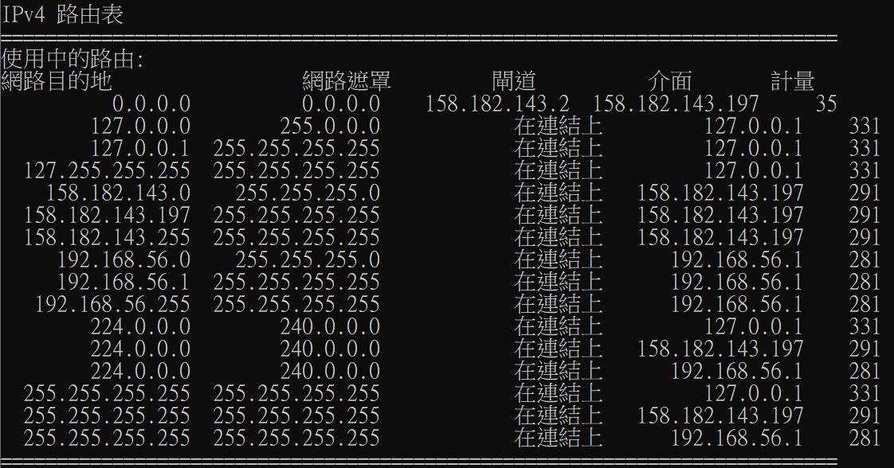
Network command: route print
route print
netstat -nr
Windows: Mac:

Slide 33
IANA IPv4 Special-Purpose Addresses
Address Block | Name
0.0.0.0/32 | “This host on this network”
127.0.0.1/8 | Loopback
255.255.255.255/32 | Limited Broadcast
Full list:
https://www.iana.org/assignments/iana-ipv4-special-registry/iana-ipv4-special-registry.xhtml

Slide 34
Network Address Translation (NAT)
Translate between private address to public address
Outgoing packets
Overwrites source addresses
Incoming packets
Overwrites destination addresses
Only outgoing connections are possible

Slide 35
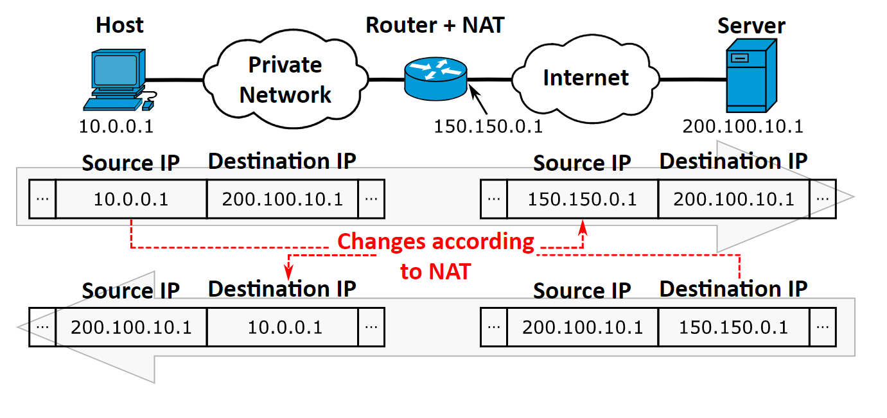
NAT example
By Michel Bakni CC BY-SA 4.0, https://commons.wikimedia.org/w/index.php?curid=86017447
Notes:
By Michel Bakni - This file was derived from:Server symbol-blue.svgNetwork cloud symbol.svgWorkstation symbol-Blue.svgRouter symbol-Blue.svgWendell Odom (2013) (in English) Cisco CCENT/CCNA ICND1 100-101 Official Cert Guide (Academic ed.), Pearson Education, Inc., p. 582 ISBN: 1587144859., CC BY-SA 4.0, https://commons.wikimedia.org/w/index.php?curid=86017447
By Michel Bakni CC BY-SA 4.0, https://commons.wikimedia.org/w/index.php?curid=86017447

Slide 36
Dynamic Host Configuration Protocol (DHCP)
Allows hosts to get an IP address automatically from a server
Do not need to assignment IP manually
Each allocation has a limited “lease” time
Hosts broadcast “Is there a DHCP server here?”
Sent to 255.255.255.255
DHCP server respond

Slide 37
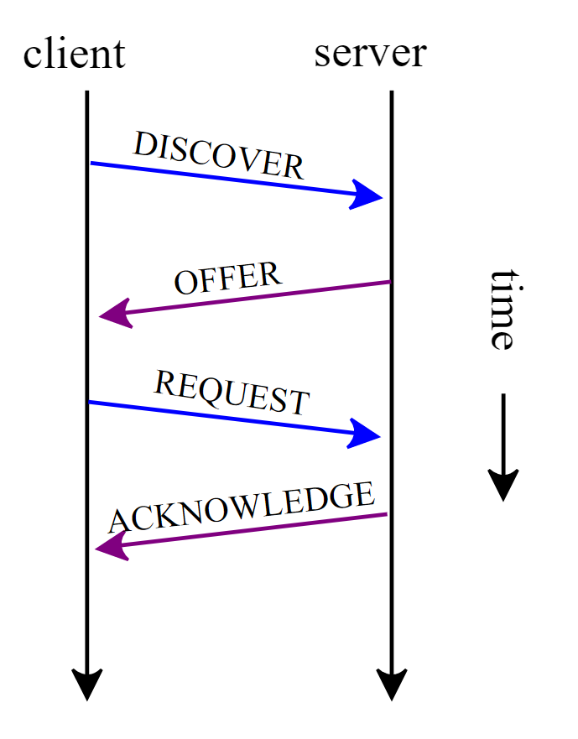
Example of DHCP session
By Gelmo96 - Own work, CC BY-SA 4.0, https://commons.wikimedia.org/w/index.php?curid=38179484

Slide 38
Forwarding & Routing
Forwarding
Input link to output link
Address prefix lookup in a table
Routing
Making the address lookup table

Slide 39
IPv6 - Addressing

Slide 40
IPv6 addressing
uses 128-bit addresses
8 groups of 4 hexadecimal digits,
each group representing 2 octets (16 bits)
groups are separated by colons.
Rules to reduce complexity
Leading Zeros: Leading zeros in a block can be omitted.
Zero Compression: One series of consecutive zero blocks in an IPv6 address can be replaced with a double colon (::).
can only be done once in an address to prevent ambiguity.

Slide 41
IPv6 – Address Compressions Example
Full address | 2001:0db8:85a3:0000:0000:8a2e:0:7334
Leading zeros | 2001:db8:85a3:0:0:8a2e:0:7334
Zero compressions | 2001:db8:85a3::8a2e:0:7334

Slide 42
Structure of IPv6 address
can include several parts:
Network Prefix
Subnet Identifier
Interface Identifier

Slide 43
Network Prefix
leading portion of the address that indicates the network segment.
often assigned by
Internet Assigned Numbers Authority (IANA)
local internet registries
Commonly 48 bits (unicast) – can vary

Slide 44
Subnet Identifier
Used to designate subnetworks within an organization's network
providing an additional layer of hierarchy
facilitating efficient routing.
Bits between network prefix & 64-bit boundary
E.g. Typical 16 bits = 49th to 64th bit

Slide 45
Interface Identifier (IID)
last 64 bits of an IPv6 address
uniquely identify an interface on a network.
often derived from the MAC address of the network interface card in a process called EUI-64,
although they can also be randomly generated to ensure privacy.

Slide 46
Example - IPv6 address structure
a simplified explanation
[Network Prefix: 48 bits] : [Subnet ID: 16 bits] : [Interface ID: 64 bits]
IPv6 address 2001:0db8:abcd:0012:0000:0000:0000:0011
Different division example
an organization might have a /32 prefix
internally divide that space into various subnets of different sizes as needed.

Slide 47
Types of addresses
For different purposes
Unicast Addresses
used for one-to-one communication
most common type of IPv6 address.
Multicast Addresses
used for one-to-many communication
a single packet is sent to multiple recipients
no broadcast addresses (multicast addresses fulfill this role
Anycast Addresses
assigned to a group of interfaces
usually on different nodes
allowing the network to route packets to the nearest node in the group.

Slide 48
Scopes of IPv6 addresses
classified into different scopes
Link-Local - used in a single network segment
Unique Local - used within a single organization
Global Unicast
used across the Internet
IPv6 equivalent of a public IPv4 address

